Slide 1
Customer Data Analysis

Slide 2
Overview
Peer Banks App size comparison
MoBank and MyCard Data Analysis from the customer playstore data
Analysis and recommendations
Notes:
Why can’t we handle directly? Coz we don’t have branches in foreign countries.
Avenues Payment (backed by Avenues India) is majorly into providing remittance assistance to customers all around the globe. Its API products are used by many banks.
Going through Avenues has advantages like flexibility in instructions based on partner (can issue specific instructions for specific partners – can issue instruction for specific APIs’ auth as well, while Datapower has standard authentation practices), holding facility (hold for the time being) and date correction (if it is held for next day). <banks would otherwise reject>. Also, Avenues ensure transmission encryption between partner and itself using key based encryption
The customer can be of any bank – the partner decides which bank the transaction should go through. So, Western Union may decide that they will do x number of transaction using RBL’s service.

Slide 3
Peer Banks App Size Comparison
Bank Name | Bank App Name | Bank App Size (MB) | Separate App for credit card(Yes/No)
RBL Bank | MoBank 2.0 | 24 | Yes
 | MyCard | 6.2
Kotak Mahindra Bank | Kotak – 811 & Mobile Banking | 18 | No
Yes Bank | YesBank | 21 | No
IndusInd Bank | IndusMobile | 57 | No
IDFC First Bank | IDFC First Bank Mobile Banking | 26 | No
Axis Bank | Axis Mobile | 26 | No
Bandhan Bank | mBandhan | 8.2 | No
Federal Bank | Federal Bank- FedMobile | 14 | No
HDFC Bank | HDFC Bank Mobile Banking | 33 | No
ICICI Bank | iMobile by ICICI Bank | 59 | No
Notes:
Customer deposits money at Western Union / UAE exchange (client), after being informed of commission and exchange rate -> The client encrypts message as per key shared by Avenues and transmits the API message -> Avenues decrypts the message and validates the message for key and limits (purpose of transaction <mandatory to mention purpose>, transaction amount directives based on purpose, etc.) and forwards the message to RBL’s IBM Datapower Gateway -> Datapower Gateway authenticates the transaction (source is Avenues) and processes the transaction (debits client account, and credit client account <send credit request over requested channel to other bank if client account in other bank>)

Slide 4
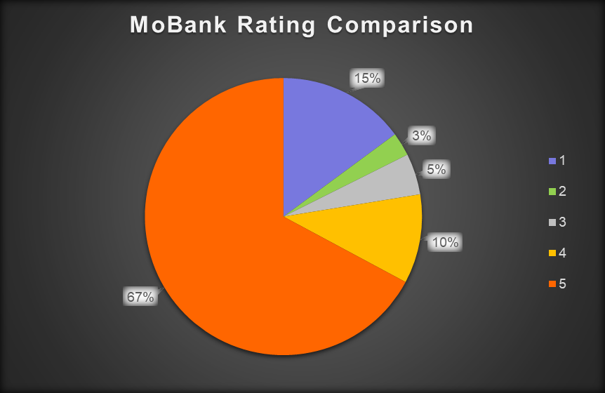
MoBank Data Analysis
About two-third of users have given 5 star rating over the past 2 months
Notes:
Why can’t we handle directly? Coz we don’t have branches in foreign countries.
Avenues Payment (backed by Avenues India) is majorly into providing remittance assistance to customers all around the globe. Its API products are used by many banks.
Going through Avenues has advantages like flexibility in instructions based on partner (can issue specific instructions for specific partners – can issue instruction for specific APIs’ auth as well, while Datapower has standard authentation practices), holding facility (hold for the time being) and date correction (if it is held for next day). <banks would otherwise reject>. Also, Avenues ensure transmission encryption between partner and itself using key based encryption
The customer can be of any bank – the partner decides which bank the transaction should go through. So, Western Union may decide that they will do x number of transaction using RBL’s service.

Slide 5
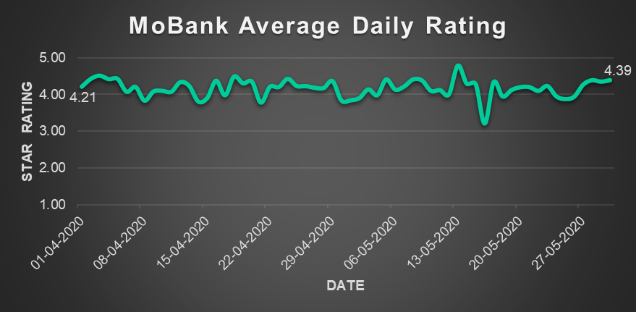
MoBank Data Analysis
Daily average rating has increased from 4.21 to 4.39 over the past 2 months
Notes:
Why can’t we handle directly? Coz we don’t have branches in foreign countries.
Avenues Payment (backed by Avenues India) is majorly into providing remittance assistance to customers all around the globe. Its API products are used by many banks.
Going through Avenues has advantages like flexibility in instructions based on partner (can issue specific instructions for specific partners – can issue instruction for specific APIs’ auth as well, while Datapower has standard authentation practices), holding facility (hold for the time being) and date correction (if it is held for next day). <banks would otherwise reject>. Also, Avenues ensure transmission encryption between partner and itself using key based encryption
The customer can be of any bank – the partner decides which bank the transaction should go through. So, Western Union may decide that they will do x number of transaction using RBL’s service.

Slide 6
MoBank Data Analysis
Total Daily Reviews Count
Date | Count | Date | Count | Date | Count | Date | Count | Date | Count
01-04 | 57 | 13-04 | 35 | 25-04 | 22 | 07-05 | 28 | 19-05 | 42
02-04 | 52 | 14-04 | 26 | 26-04 | 22 | 08-05 | 49 | 20-05 | 187
03-04 | 49 | 15-04 | 30 | 27-04 | 39 | 09-05 | 29 | 21-05 | 156
04-04 | 65 | 16-04 | 35 | 28-04 | 35 | 10-05 | 21 | 22-05 | 115
05-04 | 38 | 17-04 | 41 | 29-04 | 36 | 11-05 | 34 | 23-05 | 83
06-04 | 28 | 18-04 | 37 | 30-04 | 36 | 12-05 | 42 | 24-05 | 76
07-04 | 39 | 19-04 | 20 | 01-05 | 31 | 13-05 | 37 | 25-05 | 47
08-04 | 35 | 20-04 | 29 | 02-05 | 30 | 14-05 | 38 | 26-05 | 49
09-04 | 25 | 21-04 | 27 | 03-05 | 22 | 15-05 | 25 | 27-05 | 45
10-04 | 31 | 22-04 | 44 | 04-05 | 43 | 16-05 | 29 | 28-05 | 57
11-04 | 28 | 23-04 | 35 | 05-05 | 54 | 17-05 | 21 | 29-05 | 52
12-04 | 21 | 24-04 | 26 | 06-05 | 38 | 18-05 | 35 | 30-05 | 54
Notes:
Why can’t we handle directly? Coz we don’t have branches in foreign countries.
Avenues Payment (backed by Avenues India) is majorly into providing remittance assistance to customers all around the globe. Its API products are used by many banks.
Going through Avenues has advantages like flexibility in instructions based on partner (can issue specific instructions for specific partners – can issue instruction for specific APIs’ auth as well, while Datapower has standard authentation practices), holding facility (hold for the time being) and date correction (if it is held for next day). <banks would otherwise reject>. Also, Avenues ensure transmission encryption between partner and itself using key based encryption
The customer can be of any bank – the partner decides which bank the transaction should go through. So, Western Union may decide that they will do x number of transaction using RBL’s service.

Slide 7
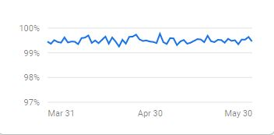
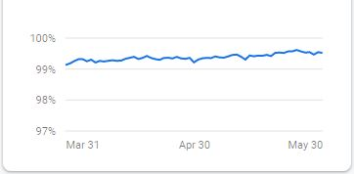
MoBank Data Analysis
Crash free statistics
Crash free users for Android Crash free users for IOS increased from 99.18% to 99.52% has increased from 99.37% to 99.46%
Notes:
Why can’t we handle directly? Coz we don’t have branches in foreign countries.
Avenues Payment (backed by Avenues India) is majorly into providing remittance assistance to customers all around the globe. Its API products are used by many banks.
Going through Avenues has advantages like flexibility in instructions based on partner (can issue specific instructions for specific partners – can issue instruction for specific APIs’ auth as well, while Datapower has standard authentation practices), holding facility (hold for the time being) and date correction (if it is held for next day). <banks would otherwise reject>. Also, Avenues ensure transmission encryption between partner and itself using key based encryption
The customer can be of any bank – the partner decides which bank the transaction should go through. So, Western Union may decide that they will do x number of transaction using RBL’s service.

Slide 8
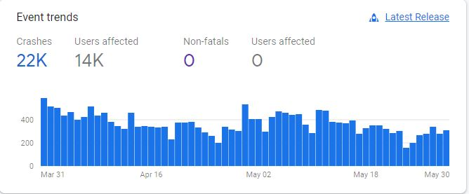
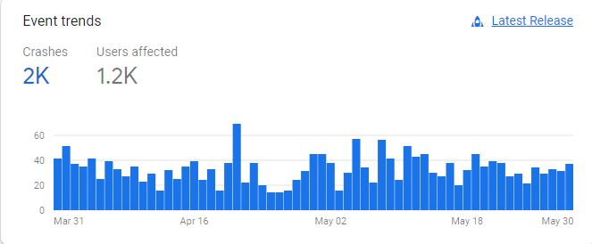
MoBank Data Analysis
Event Trends
Android
IOS
Notes:
Why can’t we handle directly? Coz we don’t have branches in foreign countries.
Avenues Payment (backed by Avenues India) is majorly into providing remittance assistance to customers all around the globe. Its API products are used by many banks.
Going through Avenues has advantages like flexibility in instructions based on partner (can issue specific instructions for specific partners – can issue instruction for specific APIs’ auth as well, while Datapower has standard authentation practices), holding facility (hold for the time being) and date correction (if it is held for next day). <banks would otherwise reject>. Also, Avenues ensure transmission encryption between partner and itself using key based encryption
The customer can be of any bank – the partner decides which bank the transaction should go through. So, Western Union may decide that they will do x number of transaction using RBL’s service.

Slide 9
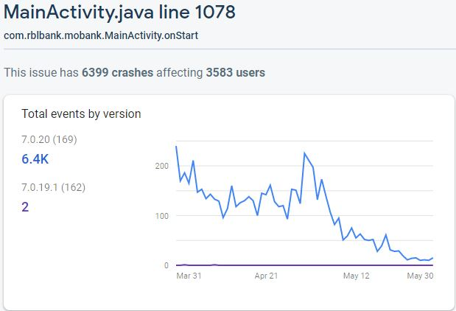
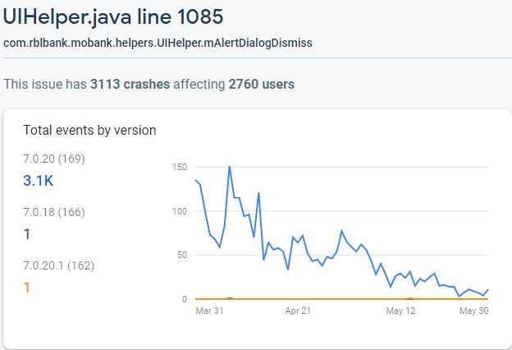
MoBank Data Analysis
Issues over time – Android
Notes:
Why can’t we handle directly? Coz we don’t have branches in foreign countries.
Avenues Payment (backed by Avenues India) is majorly into providing remittance assistance to customers all around the globe. Its API products are used by many banks.
Going through Avenues has advantages like flexibility in instructions based on partner (can issue specific instructions for specific partners – can issue instruction for specific APIs’ auth as well, while Datapower has standard authentation practices), holding facility (hold for the time being) and date correction (if it is held for next day). <banks would otherwise reject>. Also, Avenues ensure transmission encryption between partner and itself using key based encryption
The customer can be of any bank – the partner decides which bank the transaction should go through. So, Western Union may decide that they will do x number of transaction using RBL’s service.

Slide 10
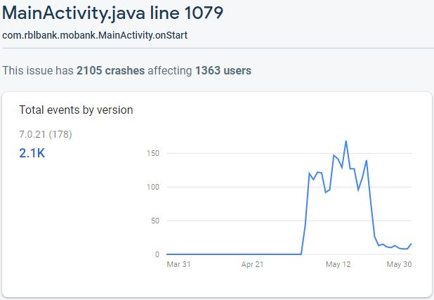
MoBank Data Analysis
Issues over time – Android
Notes:
Why can’t we handle directly? Coz we don’t have branches in foreign countries.
Avenues Payment (backed by Avenues India) is majorly into providing remittance assistance to customers all around the globe. Its API products are used by many banks.
Going through Avenues has advantages like flexibility in instructions based on partner (can issue specific instructions for specific partners – can issue instruction for specific APIs’ auth as well, while Datapower has standard authentation practices), holding facility (hold for the time being) and date correction (if it is held for next day). <banks would otherwise reject>. Also, Avenues ensure transmission encryption between partner and itself using key based encryption
The customer can be of any bank – the partner decides which bank the transaction should go through. So, Western Union may decide that they will do x number of transaction using RBL’s service.

Slide 11
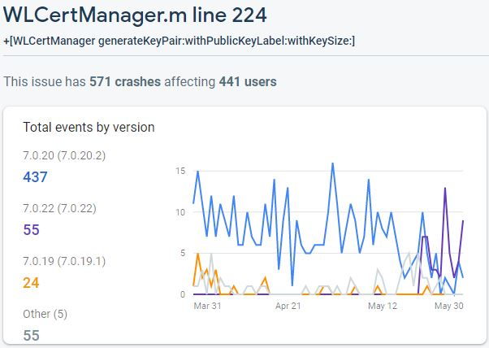
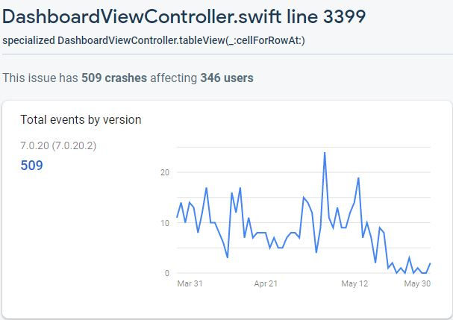
MoBank Data Analysis
Issues over time – IOS
Notes:
Why can’t we handle directly? Coz we don’t have branches in foreign countries.
Avenues Payment (backed by Avenues India) is majorly into providing remittance assistance to customers all around the globe. Its API products are used by many banks.
Going through Avenues has advantages like flexibility in instructions based on partner (can issue specific instructions for specific partners – can issue instruction for specific APIs’ auth as well, while Datapower has standard authentation practices), holding facility (hold for the time being) and date correction (if it is held for next day). <banks would otherwise reject>. Also, Avenues ensure transmission encryption between partner and itself using key based encryption
The customer can be of any bank – the partner decides which bank the transaction should go through. So, Western Union may decide that they will do x number of transaction using RBL’s service.

Slide 12
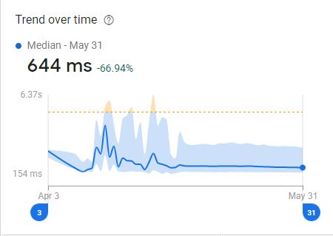
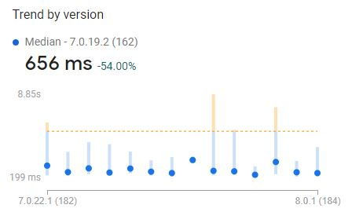
MoBank Data Analysis
App Start Time
From 1.95s to 644ms For version 8.0.0 – 475ms
Notes:
Why can’t we handle directly? Coz we don’t have branches in foreign countries.
Avenues Payment (backed by Avenues India) is majorly into providing remittance assistance to customers all around the globe. Its API products are used by many banks.
Going through Avenues has advantages like flexibility in instructions based on partner (can issue specific instructions for specific partners – can issue instruction for specific APIs’ auth as well, while Datapower has standard authentation practices), holding facility (hold for the time being) and date correction (if it is held for next day). <banks would otherwise reject>. Also, Avenues ensure transmission encryption between partner and itself using key based encryption
The customer can be of any bank – the partner decides which bank the transaction should go through. So, Western Union may decide that they will do x number of transaction using RBL’s service.

Slide 13
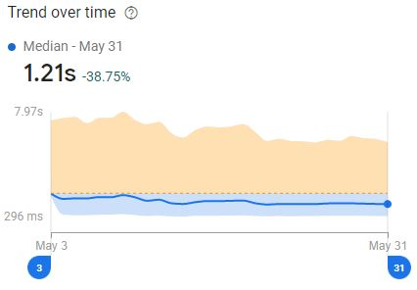
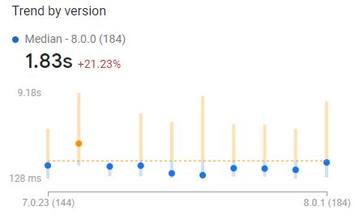
MoBank Data Analysis
App Response Time
From 1.98s to 1.21s For version 8.0.0 – 1.06s
Notes:
Why can’t we handle directly? Coz we don’t have branches in foreign countries.
Avenues Payment (backed by Avenues India) is majorly into providing remittance assistance to customers all around the globe. Its API products are used by many banks.
Going through Avenues has advantages like flexibility in instructions based on partner (can issue specific instructions for specific partners – can issue instruction for specific APIs’ auth as well, while Datapower has standard authentation practices), holding facility (hold for the time being) and date correction (if it is held for next day). <banks would otherwise reject>. Also, Avenues ensure transmission encryption between partner and itself using key based encryption
The customer can be of any bank – the partner decides which bank the transaction should go through. So, Western Union may decide that they will do x number of transaction using RBL’s service.

Slide 14
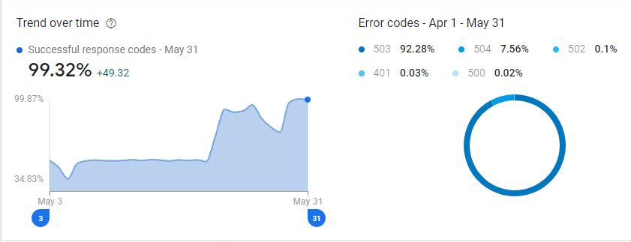
MoBank Data Analysis
App Success Rate
Notes:
Why can’t we handle directly? Coz we don’t have branches in foreign countries.
Avenues Payment (backed by Avenues India) is majorly into providing remittance assistance to customers all around the globe. Its API products are used by many banks.
Going through Avenues has advantages like flexibility in instructions based on partner (can issue specific instructions for specific partners – can issue instruction for specific APIs’ auth as well, while Datapower has standard authentation practices), holding facility (hold for the time being) and date correction (if it is held for next day). <banks would otherwise reject>. Also, Avenues ensure transmission encryption between partner and itself using key based encryption
The customer can be of any bank – the partner decides which bank the transaction should go through. So, Western Union may decide that they will do x number of transaction using RBL’s service.

Slide 15
MoBank Data Analysis
Analysis-
From 19/05 to 23/05 huge peaks for active users are observed at particular times in CleverTap and hence the increase in total daily reviews during this period
A downfall is observed during 13-05 to 16-05, the possible reasons could be-
  App average response time has increased from 1.27s to 1.43s (Crashlytics)
  From 11-05 to 12-05, the crash-free user has decreased from 99.40% to 99.31% (Crashlytics)
Notes:
Why can’t we handle directly? Coz we don’t have branches in foreign countries.
Avenues Payment (backed by Avenues India) is majorly into providing remittance assistance to customers all around the globe. Its API products are used by many banks.
Going through Avenues has advantages like flexibility in instructions based on partner (can issue specific instructions for specific partners – can issue instruction for specific APIs’ auth as well, while Datapower has standard authentation practices), holding facility (hold for the time being) and date correction (if it is held for next day). <banks would otherwise reject>. Also, Avenues ensure transmission encryption between partner and itself using key based encryption
The customer can be of any bank – the partner decides which bank the transaction should go through. So, Western Union may decide that they will do x number of transaction using RBL’s service.

Slide 16
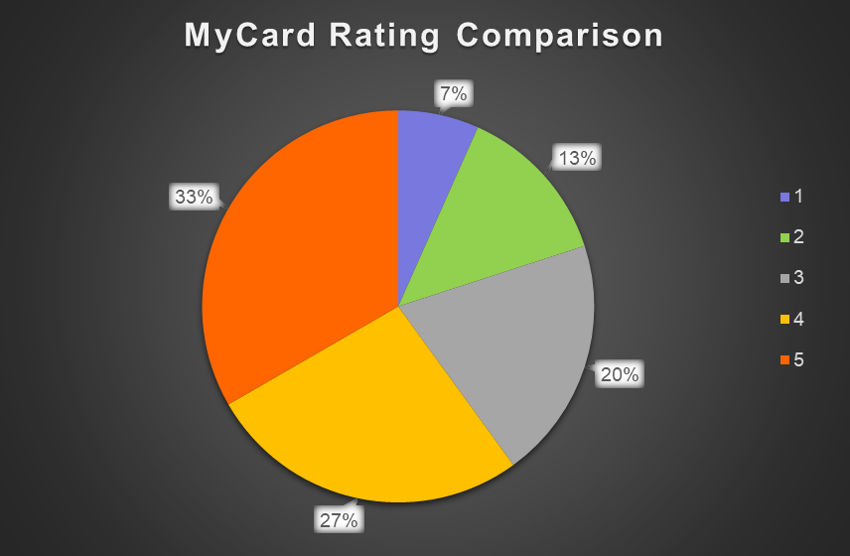
MyCard Data Analysis
Nearly one-third of the users have given 5-Star rating over the past two months
Notes:
Why can’t we handle directly? Coz we don’t have branches in foreign countries.
Avenues Payment (backed by Avenues India) is majorly into providing remittance assistance to customers all around the globe. Its API products are used by many banks.
Going through Avenues has advantages like flexibility in instructions based on partner (can issue specific instructions for specific partners – can issue instruction for specific APIs’ auth as well, while Datapower has standard authentation practices), holding facility (hold for the time being) and date correction (if it is held for next day). <banks would otherwise reject>. Also, Avenues ensure transmission encryption between partner and itself using key based encryption
The customer can be of any bank – the partner decides which bank the transaction should go through. So, Western Union may decide that they will do x number of transaction using RBL’s service.

Slide 17
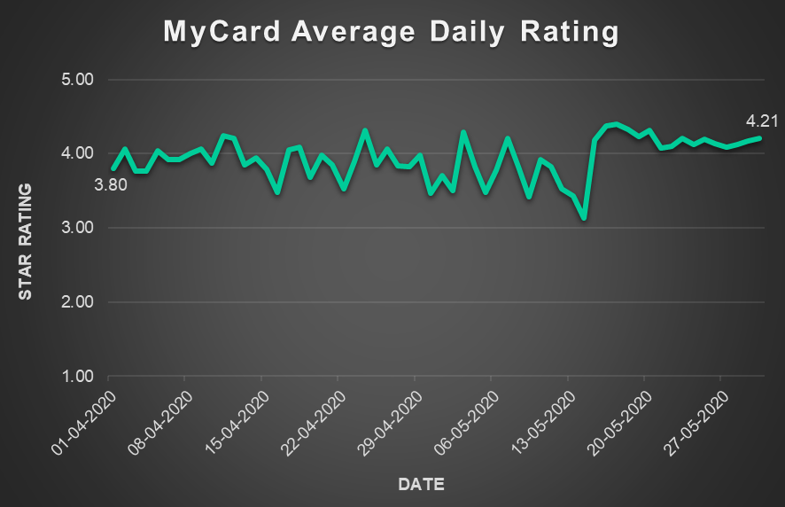
MyCard Data Analysis
Daily Average Rating has increased from 3.8 to 4.21 over the past two months
Notes:
Why can’t we handle directly? Coz we don’t have branches in foreign countries.
Avenues Payment (backed by Avenues India) is majorly into providing remittance assistance to customers all around the globe. Its API products are used by many banks.
Going through Avenues has advantages like flexibility in instructions based on partner (can issue specific instructions for specific partners – can issue instruction for specific APIs’ auth as well, while Datapower has standard authentation practices), holding facility (hold for the time being) and date correction (if it is held for next day). <banks would otherwise reject>. Also, Avenues ensure transmission encryption between partner and itself using key based encryption
The customer can be of any bank – the partner decides which bank the transaction should go through. So, Western Union may decide that they will do x number of transaction using RBL’s service.

Slide 18
MyCard Data Analysis
Total Daily Reviews Count
Date | Count | Date | Count | Date | Count | Date | Count | Date | Count
01-04 | 92 | 13-04 | 89 | 25-04 | 46 | 07-05 | 73 | 19-05 | 859
02-04 | 117 | 14-04 | 51 | 26-04 | 31 | 08-05 | 51 | 20-05 | 720
03-04 | 93 | 15-04 | 56 | 27-04 | 24 | 09-05 | 29 | 21-05 | 511
04-04 | 83 | 16-04 | 58 | 28-04 | 57 | 10-05 | 62 | 22-05 | 423
05-04 | 53 | 17-04 | 55 | 29-04 | 77 | 11-05 | 46 | 23-05 | 412
06-04 | 73 | 18-04 | 61 | 30-04 | 49 | 12-05 | 32 | 24-05 | 294
07-04 | 73 | 19-04 | 47 | 01-05 | 70 | 13-05 | 53 | 25-05 | 268
08-04 | 56 | 20-04 | 58 | 02-05 | 68 | 14-05 | 44 | 26-05 | 259
09-04 | 68 | 21-04 | 45 | 03-05 | 87 | 15-05 | 302 | 27-05 | 284
10-04 | 63 | 22-04 | 57 | 04-05 | 47 | 16-05 | 2324 | 28-05 | 234
11-04 | 66 | 23-04 | 46 | 05-05 | 42 | 17-05 | 1299 | 29-05 | 273
12-04 | 115 | 24-04 | 64 | 06-05 | 49 | 18-05 | 1127 | 30-05 | 234
Notes:
Why can’t we handle directly? Coz we don’t have branches in foreign countries.
Avenues Payment (backed by Avenues India) is majorly into providing remittance assistance to customers all around the globe. Its API products are used by many banks.
Going through Avenues has advantages like flexibility in instructions based on partner (can issue specific instructions for specific partners – can issue instruction for specific APIs’ auth as well, while Datapower has standard authentation practices), holding facility (hold for the time being) and date correction (if it is held for next day). <banks would otherwise reject>. Also, Avenues ensure transmission encryption between partner and itself using key based encryption
The customer can be of any bank – the partner decides which bank the transaction should go through. So, Western Union may decide that they will do x number of transaction using RBL’s service.

Slide 19
MyCard Data Analysis
Analysis-
From 14-05 to 17-05, the average daily rating has increased by nearly 40% probably due to following reasons -
  One could be there was an update of app on 14th of May
  Other reason could be due to increase in total number of daily reviews from 44 on 14th to 1299 on 17th May
Notes:
Why can’t we handle directly? Coz we don’t have branches in foreign countries.
Avenues Payment (backed by Avenues India) is majorly into providing remittance assistance to customers all around the globe. Its API products are used by many banks.
Going through Avenues has advantages like flexibility in instructions based on partner (can issue specific instructions for specific partners – can issue instruction for specific APIs’ auth as well, while Datapower has standard authentation practices), holding facility (hold for the time being) and date correction (if it is held for next day). <banks would otherwise reject>. Also, Avenues ensure transmission encryption between partner and itself using key based encryption
The customer can be of any bank – the partner decides which bank the transaction should go through. So, Western Union may decide that they will do x number of transaction using RBL’s service.

Slide 20
MyCard Data Analysis
Key Customer reviews-
Overall Bad customer care service
Wrong / Extra charges
Bank payment options are limited
No option for customer helpline in the app
No option to redeem reward points in app
Decrease in credit card limit
User friendly because of new update from 14th May
Notes:
Bank Payment (3962, 9697, 9867, )

Slide 21
MyCard Data Analysis
Recommendations-
To overcome from bad customer care service, we can have automated replies based on feedback
Tie up with other banks in order to provide the customer more payment options through their credit card
We can add customer helpline (or adding a chatbot) and redeem reward options in MyCard app
Notes:
Why can’t we handle directly? Coz we don’t have branches in foreign countries.
Avenues Payment (backed by Avenues India) is majorly into providing remittance assistance to customers all around the globe. Its API products are used by many banks.
Going through Avenues has advantages like flexibility in instructions based on partner (can issue specific instructions for specific partners – can issue instruction for specific APIs’ auth as well, while Datapower has standard authentation practices), holding facility (hold for the time being) and date correction (if it is held for next day). <banks would otherwise reject>. Also, Avenues ensure transmission encryption between partner and itself using key based encryption
The customer can be of any bank – the partner decides which bank the transaction should go through. So, Western Union may decide that they will do x number of transaction using RBL’s service.

